Slide 1

Automating Workflows with Python and AI

Slide 2
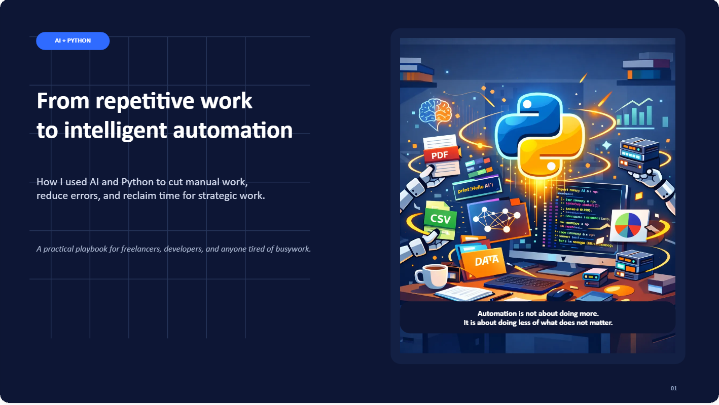

Slide 3
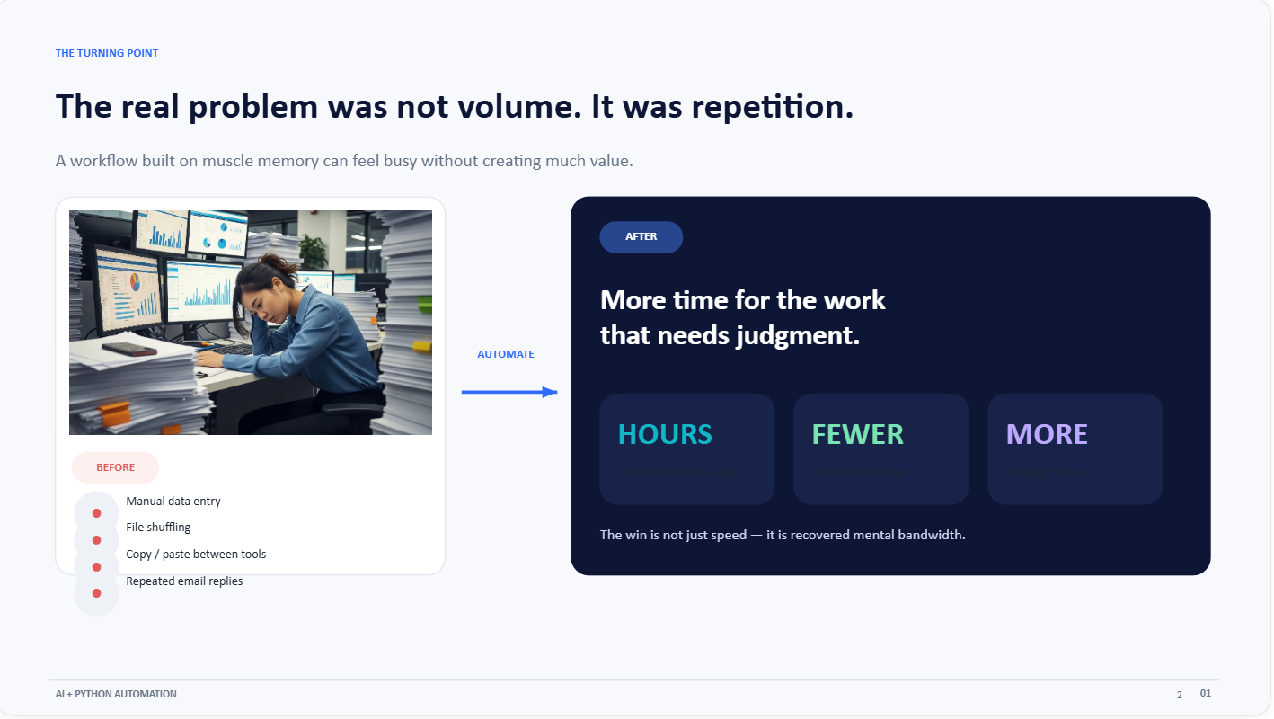

Slide 4
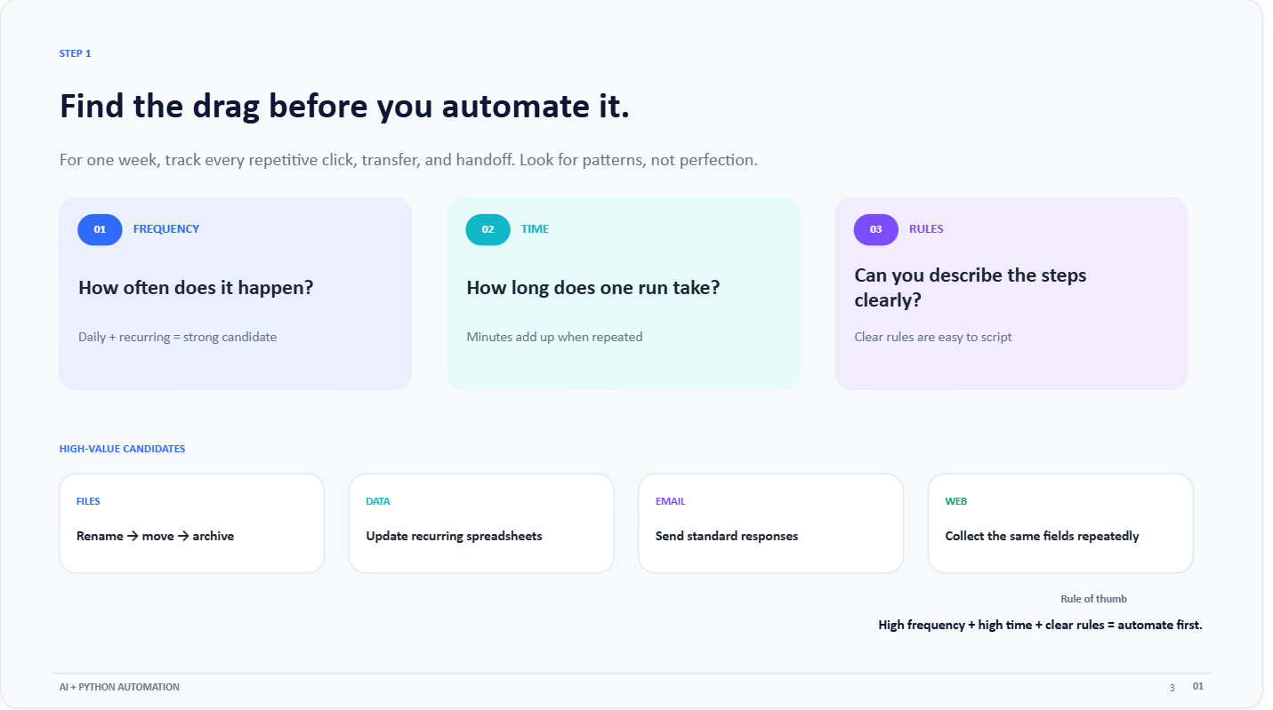

Slide 5
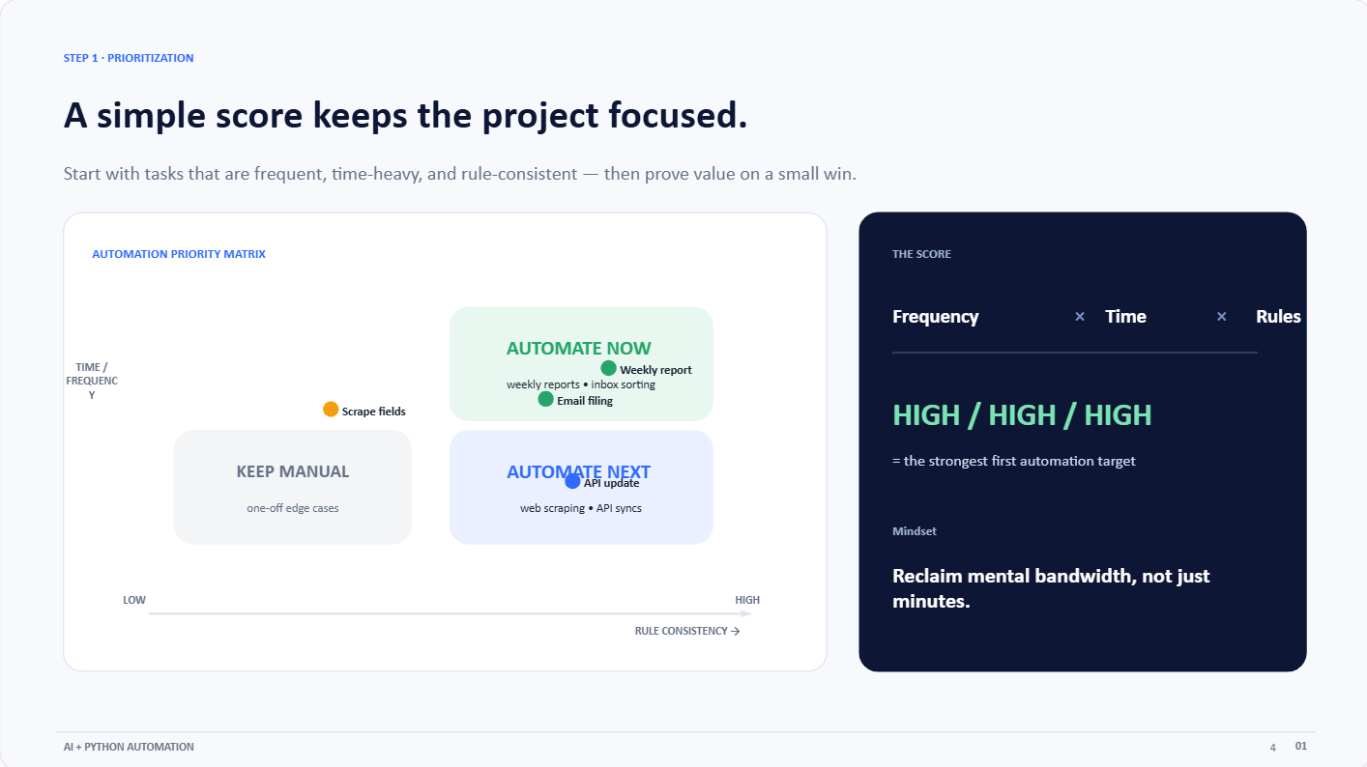

Slide 6
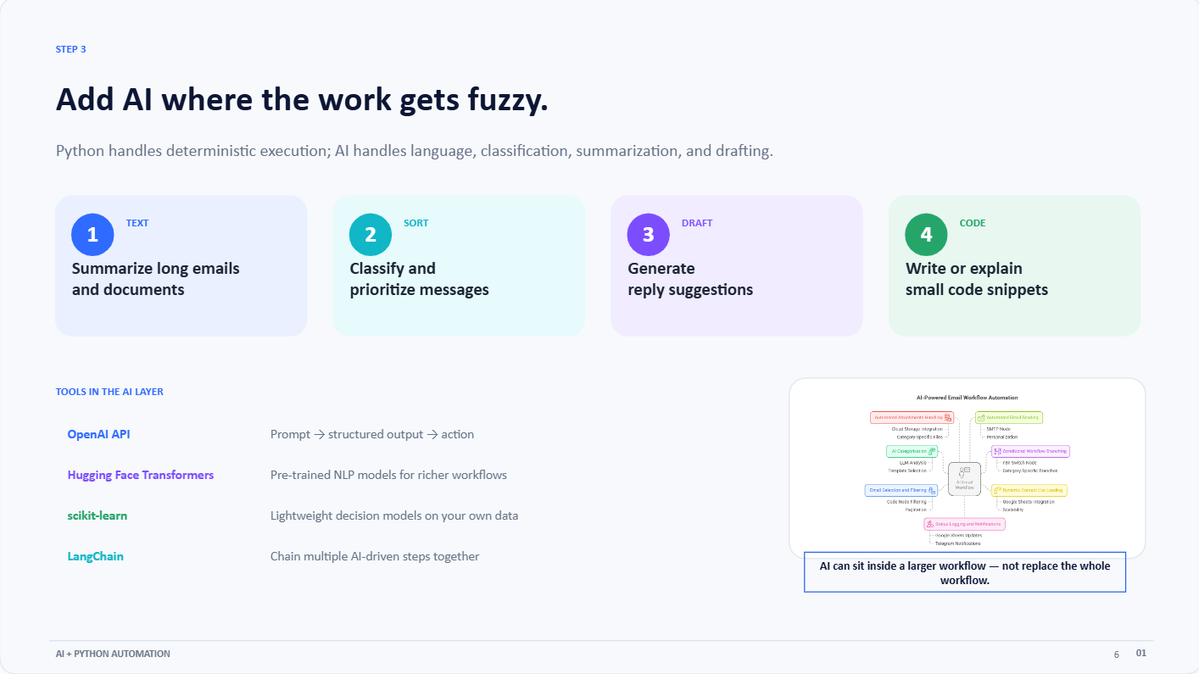

Slide 7
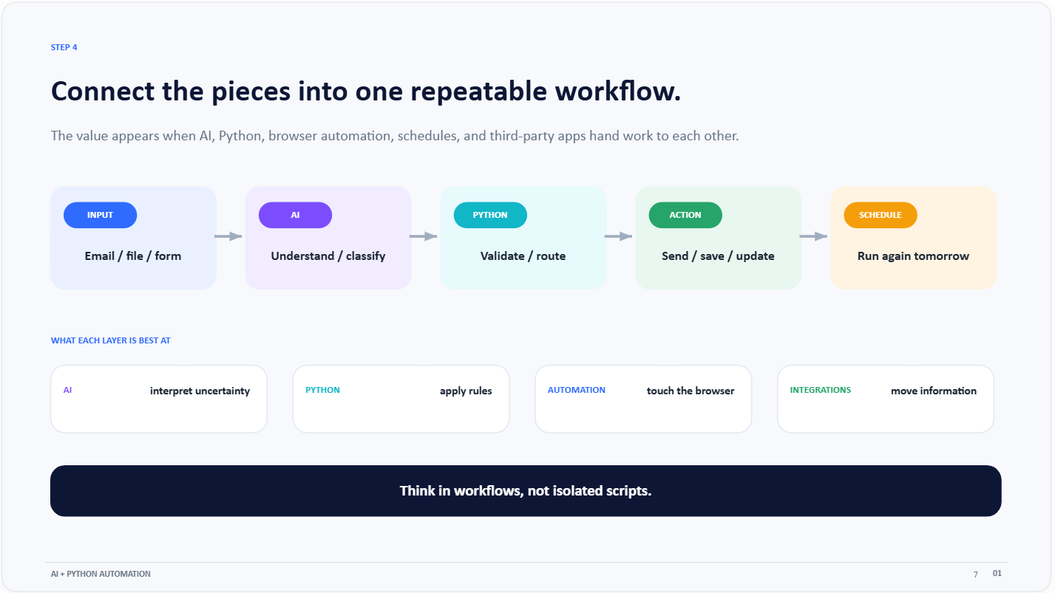

Slide 8
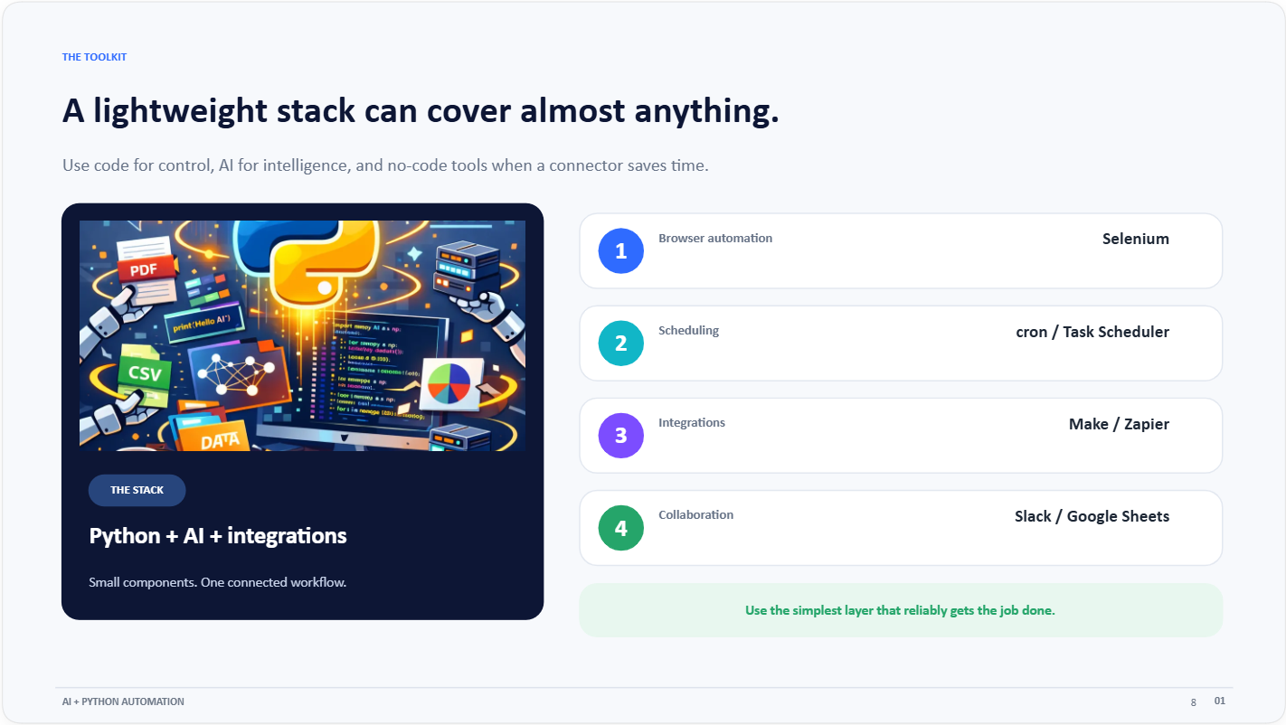

Slide 9
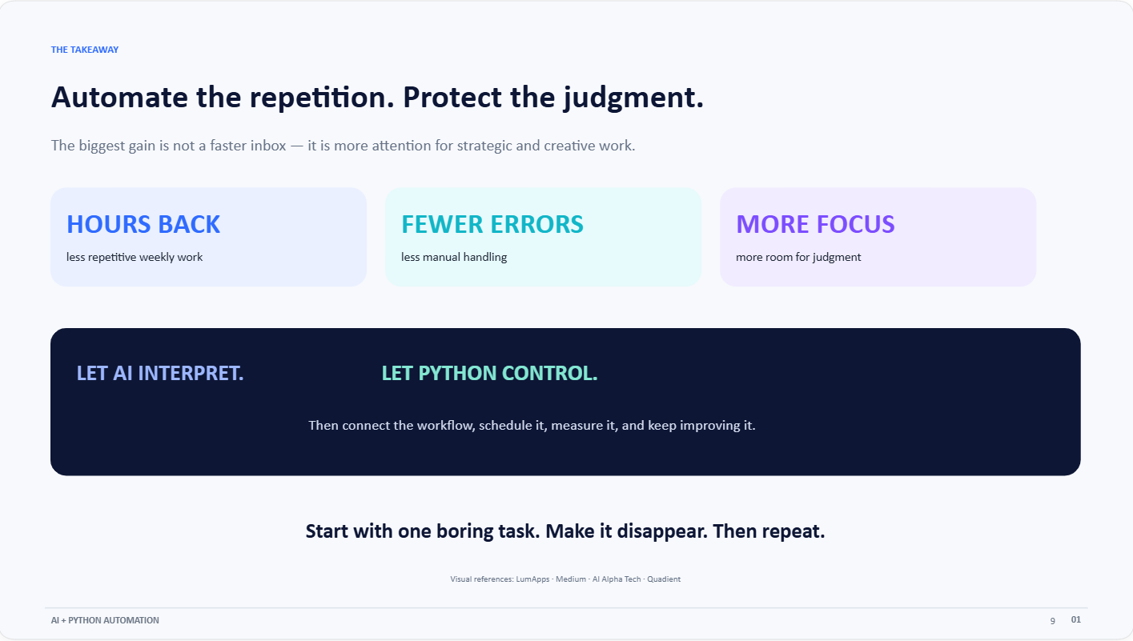

Slide 10

Automation Examples

Slide 11
Example 1: Automating Email Sorting and Responses with NLP
Example 1: Automating Email Sorting and Responses with NLP
Just sorting through my inbox used to take up an absurd amount of my time. In order to resolve this, I wrote a Python script that uses IMAP to access my email account, scans incoming messages, uses an NLP model to categorize them according to keywords, and then directs them to folders (such as “Clients,” “Invoices,” and “Ignore”).

Slide 12
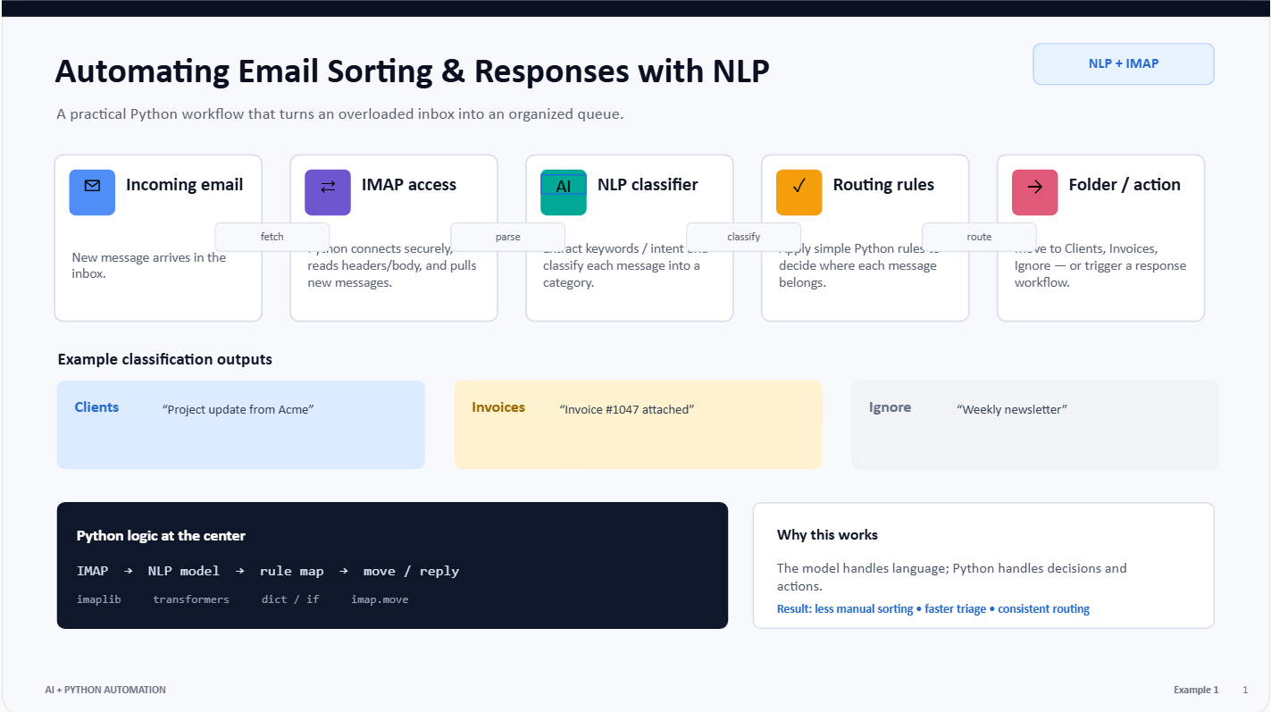

Slide 13
Example 2: Web Scraping and Report Generation
Every Monday, I check a dozen sites for analytics, pricing, and competitor updates. I automated this using BeautifulSoup for scraping and Jinja2 for templated reports.
Later, I extended it with Matplotlib for charts and scheduled it via a cron job, emailing the result with smtplib.

Slide 14
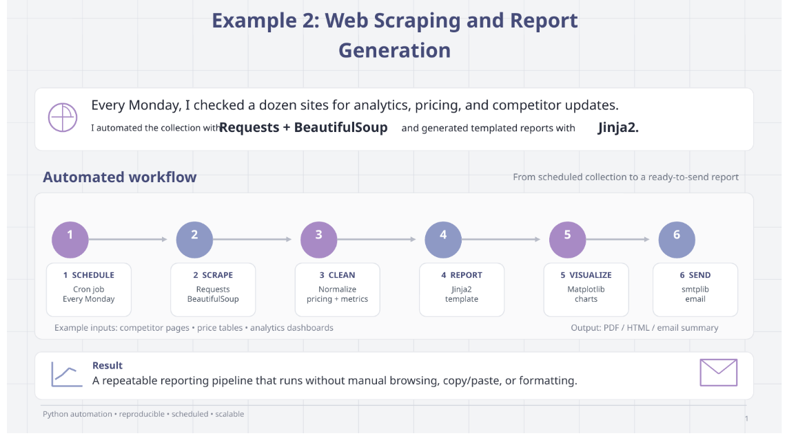

Slide 15
Example 3: Using AI for Decision Support and Summarization
When reviewing lengthy strategy documents or call transcripts, I often needed to condense them for quick action. Instead of skimming, I built a script using OpenAI’s GPT API to summarize and highlight key action items.
This script cut down my review time dramatically — from 30 minutes to under 5.

Slide 16
